Slide 1
Instructions for use
This resource is not a teaching and learning program. It should be used in conjunction with Stage 3 Year A Unit 18.
Classroom teachers are encouraged to add and adapt slides as required to meet the needs of their students.
Save a copy of the file to make changes to the slide deck. Go to File > Download a Copy (this downloads a copy to the computer to edit in the PowerPoint app).
To convert the PowerPoint to Google Slides:
  Upload the file into Google Drive and open it.
  Go to File > Save as Google Slides.
  (Note – conversion may cause formatting changes in the slides.)

Slide 2

Review of Learning
Mathematics Stage 3 – Unit 18
Notes:
Reviews may include a combination of question types, requiring students to recall facts and key ideas, as well as apply their knowledge to solve problems and answer questions. To support active engagement, a mix of techniques should be employed.” (AERO, 2024).
This Review of Learning slide deck revisits key concepts from the following units:
Stage 3 Year A Unit 18
Stage 3 Year A Unit 17
Stage 3 Year A Unit 16
It also includes opportunities to review prior learning in non-number content, supporting consolidation across focus areas.
The review of learning resources include three key task types that support the development of mathematical proficiency through retrieval, spaced practice, and active participation. These practices complement the review phase (activating prior knowledge) embedded within the beginning of each lesson.
1.
Multiple-choice questions/True or false: Designed to promote active retrieval of key concepts and identify common misconceptions in number, supporting consolidation, understanding and fluency.
These questions:
support spaced and interleaved practice
help identify and address common misconceptions
support active recall and immediate feedback
support whole class participation
identify areas requiring reteach
2.
Short-response question sets: Carefully grouped questions that encourage spaced and interleaved practice across multiple focus areas, helping students revisit and apply knowledge from different points in time.
These questions:
have a combination of question types
address a range of focus areas
build automaticity and fluency
support active recall
allow for immediate feedback
identify content requiring reteach
3.
Developing number sense activities: A variety of practical, purposeful tasks that reinforce current learning and build on prior knowledge. These activities promote reasoning, problem-solving and conceptual understanding.
The review of learning resources are designed to work support teaching and learning in mathematics. For the most effective implementation, use the resources flexibly, adapting to meet student learning needs and individual classroom contexts.

Slide 3
Lessons
1
Review of learning 1
5
Review of learning 5
2
Review of learning 2
6
Review of learning 6
3
Review of learning 3
7
Review of learning 7
4
Review of learning 4
8
Review of learning 8
Notes:
Teacher notes:
Click lesson numbers to go to specific lessons
Interactive features can be viewed in slide show

Slide 4
Review of learning 1

Slide 5

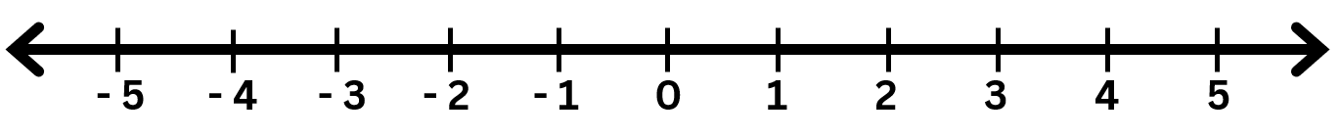
Multiple choice (1)
Which letter shows the solution to
3 – 7 = ?
A
B
C
D
Notes:
This question connects to the content in the developing number sense activity (Activity 1)
Syllabus focus area:
Represents numbers B

Slide 6

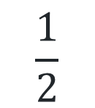
Short response (1)
Nat tosses a coin. Which word describes the probability of it landing on heads?
$$\frac{1}{2}$$
0 1
Impossible equally likely certain
Notes:
Short response questions provide brisk paced questions focussing on review of current and previous content to support spaced and interleaved practice.
Syllabus focus area:
Chance A

Slide 7
Short response (2)
Halving can be used to solve 6 × 500 by:
Record how to use halving to solve
8 × 5000
halving 6 (= 3) and doubling 500 (= 1000)
then, 3 × 1000 = 3000
Notes:
Short response questions provide brisk paced questions focussing on review of current and previous content to support spaced and interleaved practice.
Syllabus focus area:
Multiplicative relations A

Slide 8
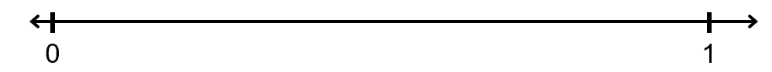
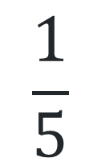
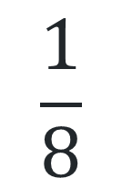
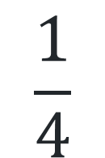
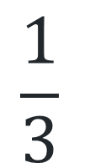
Short response (3)
Which fraction is closest to one-half?
Use the number line to show your reasoning.
$$\frac{1}{5}$$
$$\frac{1}{8}$$
$$\frac{1}{4}$$
$$\frac{1}{3}$$
8
Notes:
Short response questions provide brisk paced questions focussing on review of current and previous content to support spaced and interleaved practice.
Syllabus focus area:
Representing quantity fractions A

Slide 9
Short response (4)
Record the size of the angle shown
on the protractor.
Notes:
Short response questions provide brisk paced questions focussing on review of current and previous content to support spaced and interleaved practice.
Syllabus focus area:
Geometric measure A: Angles

Slide 10

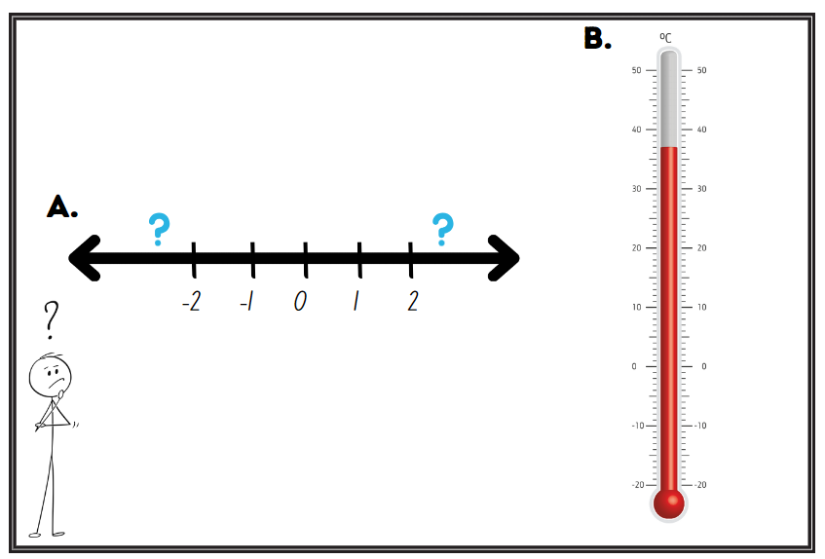
Activity 1 – locate and represent integers on a number line (1)
Notes:
This is a developing number sense activity.
Number sense refers to a deep understanding of numbers, including their magnitude, relationships, and the effects of operations on them. It supports fluency and understanding, estimation, flexible thinking, and efficient problem-solving. Number sense activities 1–4 ‘activate’ prior number knowledge and support the learning of new content in the unit. Number sense activities 5–8 ‘loop’ back and provide opportunity for spaced practice with concepts and procedures covered in previous units.
Syllabus focus area:
Represents numbers B
Locate and represent integers on a number line (1)
This resource corresponds to Resource 17 – integers in Stage 3 Year A Unit 18.
Note: integers are the negative and positive whole numbers and zero. Integers can be represented as a series, such as -3, -2, -1, 0, 1, 2, 3. Positive and negative numbers describe quantities having both magnitude and direction, for example, temperature above and below zero (Van De Walle et al. 2019).
Display Resource 17 – integers and provide students with individual whiteboards and writing materials.
Use a think-aloud to explain the differences and similarities between the number line and the temperature gauge.
Ask:
What role does the zero have in both number lines? (it marks the point between negative and positive numbers)
What is the lowest number on each of the number lines? (-2 and −20)
How far could number line A be extended in either direction? (forever)
Where might you see and use negative numbers in real life situations? (temperature, finance)
Students turn and talk to discuss these questions with a partner.
Select a student at random to share their thinking. Repeat with a different student. Explain and reteach content as required prior to moving to new learning.
Explain that integers are whole numbers and can be either positive or negative. Zero is an exception, as it is neither positive nor negative and has an important role as it sits in the middle, separating the negative and positive numbers.
Draw student attention to Resource 17 – integers. Using their individual whiteboard, students draw the number line labelled ‘A’ and extend the number line by recording the next 3 positive and negative integers.
Ask:
What strategy did you use to determine the next integers?
How do you know you are correct?
Check for understanding by asking students to hold up their individual whiteboards to show their number lines. Scan student work and revisit learning if required.

Slide 11
Review of learning 2

Slide 12
True or false (1)
Faiyaz calculated that 3 - 5 = -2.
True | False
Notes:
The question on this slide connects to the content being explored in the developing number sense activity (Activity 2)
Syllabus focus area:
Represents numbers B

Slide 13
Short response 1
Write the definition of the word probability.
Notes:
Short response questions provide brisk paced questions focussing on review of current and previous content to support spaced and interleaved practice.
Syllabus focus area:
Chance A

Slide 14
Short response (6)
Record how to use halving to find
the product of 8 × 500
Notes:
Short response questions provide brisk paced questions focussing on review of current and previous content to support spaced and interleaved practice.
Syllabus focus area:
Multiplicative relations A

Slide 15

Short response (7)
Which fraction card doesn’t belong?
Explain your reasoning.
?
1-eighth
Notes:
Short response questions provide brisk paced questions focussing on review of current and previous content to support spaced and interleaved practice.
Syllabus focus area:
Representing quantity fractions A

Slide 16
Short response (8)
Stormi measured one side of the
regular octagon and found its length was
6 cm. What is the perimeter of the shape?
6 cm
Notes:
Short response questions provide brisk paced questions focussing on review of current and previous content to support spaced and interleaved practice.
Syllabus focus area:
Geometric measure A: Length

Slide 17
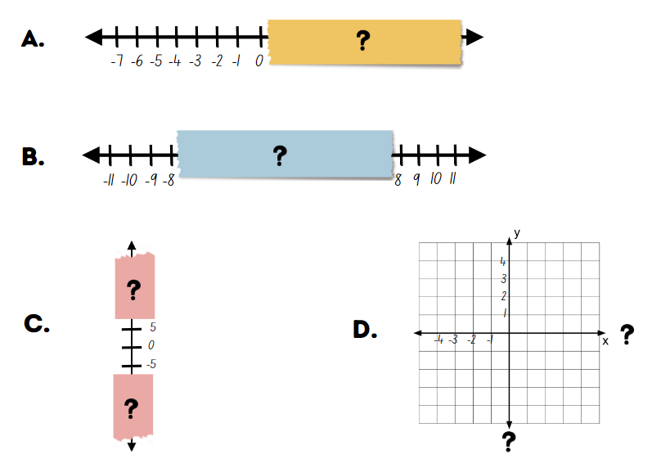
Activity 2 – locate and represent integers on a number line (2)
Notes:
This is a developing number sense activity.
Number sense refers to a deep understanding of numbers, including their magnitude, relationships, and the effects of operations on them. It supports fluency and understanding, estimation, flexible thinking, and efficient problem-solving. Number sense activities 1–4 ‘activate’ prior number knowledge and support the learning of new content in the unit. Number sense activities 5–8 ‘loop’ back and provide opportunity for spaced practice with concepts and procedures covered in previous units.
Syllabus focus area:
Represents numbers B
Locate and represent integers on a number line (2)
This resource corresponds to Resource 18 – missing integers in Stage 3 Year A Unit 18.
Display Resource 18 – missing integers.
Model how to find the missing integers on number line A using a think-aloud, explaining the importance of equal distances between increments.
Ask. How did you know what the highest integer would be on number line A?
Select a student at random to explain their thinking.
Provide pairs of students with Resource 18 – missing integers. Students work with their partner to find the missing integers in number lines B and C, and in cartesian plane D. Remind students that the integers for coordinates align with the lines, not the spaces.
As students are working with their partners, use effective feedback linked to syllabus content points to support student understanding.
Ask:
How did you know what the highest integer would be on number line A?
How did you know where to place zero on number line B?
What was different about number line C?
Which number line was most challenging?
What strategy did you use to label the unlabelled axes on the Cartesian plane? How did you know you were correct?
Select a student at random to share their thinking. Repeat with a different student.
Explain and reteach content as required prior to moving to new learning.

Slide 18
Review of learning 3

Slide 19
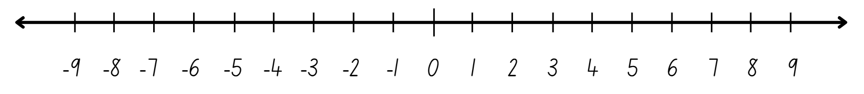
Multiple choice (2)
Frankie has $5 but wants to buy a $12 book.
Which letter shows the amount she borrows?
A
B
C
D
$5
$6
$7
$8
Notes:
This question connects to the content in the developing number sense activity (Activity 3)
Syllabus focus area:
Represents numbers B

Slide 20
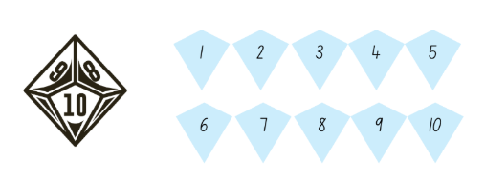
Short response (9)
How many different numbers can you roll?
What is the probability of rolling an 8?
What is the probability of rolling a 2?
Notes:
Short response questions provide brisk paced questions focussing on review of current and previous content to support spaced and interleaved practice.
Syllabus focus area:
Chance A

Slide 21
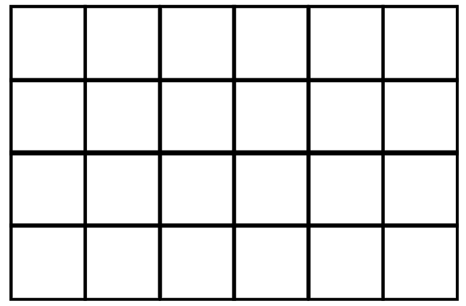
Short response (10)
Both shapes have the same area of square centimetres. What could be the length and width of the second shape?
Notes:
Short response questions provide brisk paced questions focussing on review of current and previous content to support spaced and interleaved practice.
Syllabus focus area:
Two-dimensional spatial structure A: Area

Slide 22
Short response (11)
Record the missing equivalent benchmark fractions, decimals and percentages.
Fraction | Decimal | Percentage
 | 0.25
 |  | 50%
 | 0.75
 |  | 100%
Notes:
Short response questions provide brisk paced questions focussing on review of current and previous content to support spaced and interleaved practice.
Syllabus focus area:
Represents numbers B: Decimals and percentages

Slide 23
Short response (12)
Rory said this is an isosceles triangle because it has 2 equal sides and
2 equal angles. Is he correct?
Draw and label a diagram to show
your reasoning.
Notes:
Short response questions provide brisk paced questions focussing on review of current and previous content to support spaced and interleaved practice.
Syllabus focus area:
Two-dimensional spatial structure A: 2D Shapes

Slide 24

Activity 3 – locate and represent integers on a number line (3)
This line graph shows the submarine’s depth over a week.
15m
10m
5m
sea level
0
-5m
-10m
-15m
-20m
-25m
-30m
Monday
Tuesday
Wednesday
Thursday
Friday
Notes:
This is a developing number sense activity.
Number sense refers to a deep understanding of numbers, including their magnitude, relationships, and the effects of operations on them. It supports fluency and understanding, estimation, flexible thinking, and efficient problem-solving. Number sense activities 1–4 ‘activate’ prior number knowledge and support the learning of new content in the unit. Number sense activities 5–8 ‘loop’ back and provide opportunity for spaced practice with concepts and procedures covered in previous units.
Syllabus focus area:
Represents numbers B
Locate and represent integers on a number line (3)
This resource corresponds to Resource 19 – integers below zero in Stage 3 Year A Unit 18.
Explain that sea level is the base level for measuring elevation and depth on Earth. For example, Mount Kosciuszko is 2 228 metres above sea level. At its deepest point, the Mariana Trench is about 11 000 metres below sea level.
Display Resource 19 – integers below zero. Explain that like temperature, the measurement above and below sea level can be recorded with positive and negative integers.
Using a think-aloud, locate zero on the vertical axis. Highlight that the negative numbers are continuous in one direction and the positive numbers are continuous in the opposite direction, like a mirror image.
Read the description of HMAS Collins’ movements over the week while it has been in training. Explain that this line graph shows the depths of the submarine in the last week of training.
Ask:
How is this graph similar and/or different to a column graph?
What information is recorded on the horizontal axis?
What information is recorded on the vertical axis?
How many times was the submarine at 20 metres below sea level?
Students turn and talk to discuss these questions with a partner.
Select a student at random to share their thinking. Repeat with a different student. Explain and re-teach content as required prior to moving to new learning.
Model how to describe the movement of the submarine. For example: At the beginning of Monday, the submarine was at sea level, 0 m. It dived 15 m to be at 15 m below sea level, then rose 5 m to be at 10 m below sea level by the end of the day.
Provide pairs with a whiteboard and writing materials.
Students write 2 questions that can be answered from the graph.
Select students at random to ask their questions to the class. Select different students to answer the questions using information from the line graph.

Slide 25
Review of learning 4

Slide 26
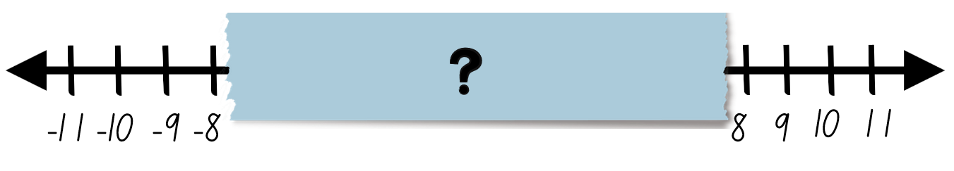
True or false (2)
The solution to 9 – 11
is an even negative integer.
True | False
Notes:
The question on this slide connects to the content being explored in the developing number sense activity (Activity 4)
Syllabus focus area:
Represents numbers B

Slide 27
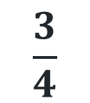
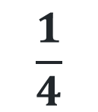
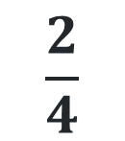
Short response (13)
Jen randomly gets a handball from the bag. Which fraction describes the probability of her getting the
blue handball? Record your reasoning.
$$\frac{1}{4}$$
$$\frac{2}{4}$$
$$\frac{3}{4}$$
0 1
27
Notes:
Short response questions provide brisk paced questions focussing on review of current and previous content to support spaced and interleaved practice.
Syllabus focus area:
Chance A

Slide 28
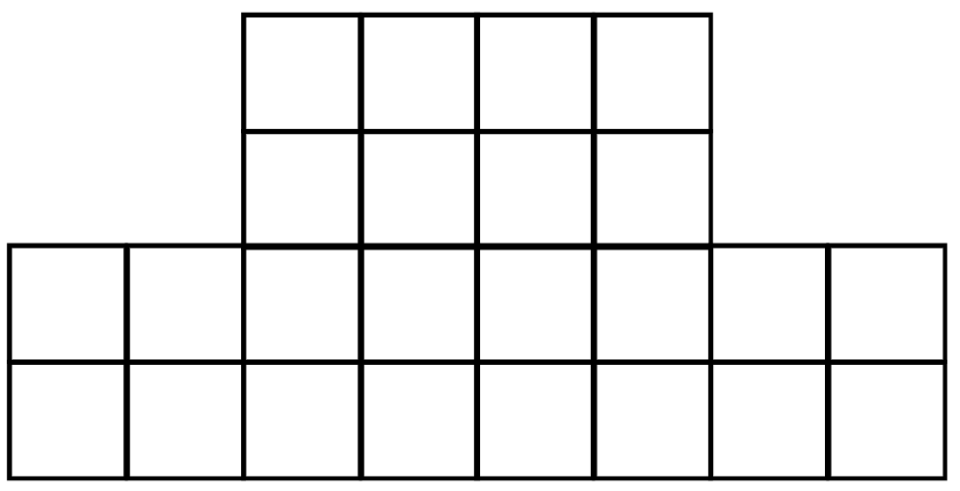
Short response (14)
Partition the composite shape to find the area in square metres. Record your reasoning.
Notes:
Short response questions provide brisk paced questions focussing on review of current and previous content to support spaced and interleaved practice.
Syllabus focus area:
Two-dimensional spatial structure B: Area

Slide 29
Short response (15)
Braxton knows that a 10% discount off the price of a game for $120 is $12.
How much would he save with discounts of:
20%
25%
40%
Notes:
Short response questions provide brisk paced questions focussing on review of current and previous content to support spaced and interleaved practice.
Syllabus focus area:
Represents numbers B: Decimals and percentages

Slide 30
Short response (16)
Record 2 other ways of communicating the time:
1800 hours
Be prepared to share your responses.
Notes:
Short response questions provide brisk paced questions focussing on review of current and previous content to support spaced and interleaved practice.
Syllabus focus area:
Non-spatial measure A: Time

Slide 31
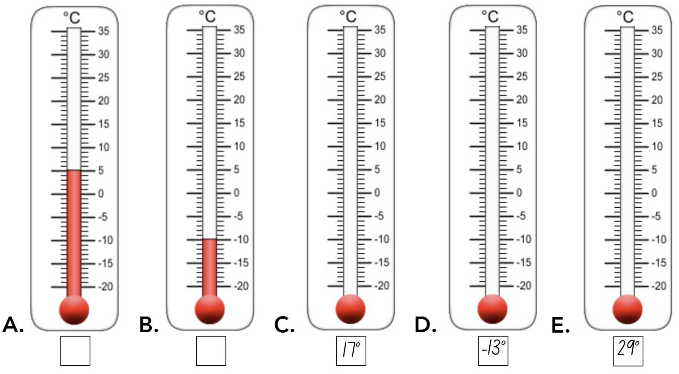
Activity 4 – locate and represent integers on a number line (4)
Notes:
This is a developing number sense activity.
Number sense refers to a deep understanding of numbers, including their magnitude, relationships, and the effects of operations on them. It supports fluency and understanding, estimation, flexible thinking, and efficient problem-solving. Number sense activities 1–4 ‘activate’ prior number knowledge and support the learning of new content in the unit. Number sense activities 5–8 ‘loop’ back and provide opportunity for spaced practice with concepts and procedures covered in previous units.
Syllabus focus area:
Represents numbers B: Whole numbers
Locate and represent integers on a number line (4)
This resource corresponds to Resource 32 – reading a thermometer in Stage 3 Year A Unit 18.
Display Resource 32 – reading a thermometer. Provide each student with a copy.
Model how to read thermometer A. Use a think aloud to draw students’ attention to where zero is and how far the temperatures extend into positive and negative integers.
Students determine the temperature represented on thermometer B, and colour thermometers C, D and E to show the labelled temperatures.
As students are working, use effective feedback linked to syllabus content points to support student understanding.
Select students at random to share their answers. Repeat with different students. Revisit learning as required.

